Slide 1

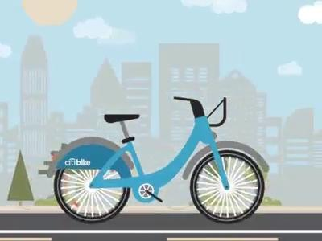
CitiBike:
Neighborhood Analysis
Anthony Pereira, Emily Frenkel,
Paul Perez, Vanessa Lai
Notes:
https://www.citibikenyc.com/system-data
Video:
https://dribbble.com/shots/4851586-CitiBike

Slide 2
Neighborhood Analysis
Correlation Exploration
Notes:
Hello my name is Paul Perez and for this section I will attempt to answer the question:
How does the population of a neighborhood influence the usage rate of Citi Bike for that neighborhood?
Sources:
https://www.citibikenyc.com/system-data
https://www.zipdatamaps.com/
https://newyork.hometownlocator.com/zip-codes/
https://www.towncharts.com/New-York/New-York-state-Demographics-data.html
---

Slide 3
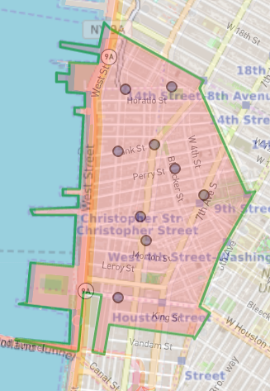
Neighborhood Analysis
What population demographics of a neighborhood determine the usage rate of Citi Bike?
Correlate rides data with population data
by zip code
Sources: Citi Bike System Data, Zipdatamaps,
New York Hometown Locator, Towncharts
Notes:
Are wealthier, more-educated neighborhoods more likely or less likely to use Citi Bike?
Does the diversity of the neighborhood influence the usage rate?
How about the population size or average household size of the neighborhood?
To answer these questions:
Using the zip codes of the neighborhoods
I used the rides data from the citi bike web page
and measured it against demographics data from other sources
to see if there is a connection between the two.

Slide 4
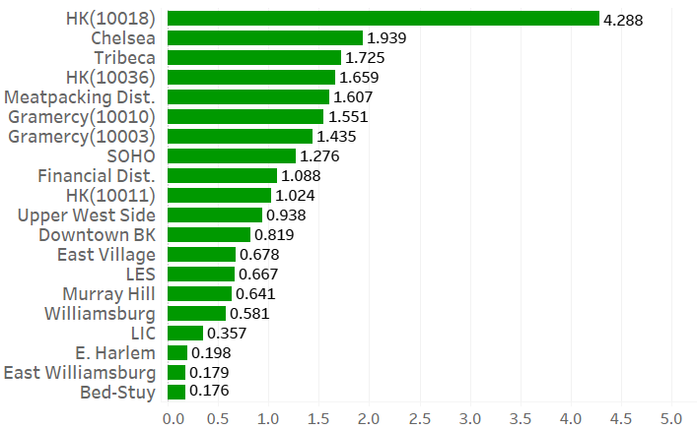
Rides per Person (by Zip Code)
Sources: Citi Bike System Data, Zipdatamaps, New York Hometown Locator, Towncharts,
Patch
Notes:
This is a graph of rides per person - for each neighborhood in the sample. Hell’s Kitchen is an outlier - it has more than twice the amount of rides per person
compared to the next highest neighborhood. This checks out as Citi Bike’s largest station - which has a 79 bike capacity - is located around the Hell’s Kitchen area.
https://patch.com/new-york/midtown-nyc/citys-largest-citi-bike-station-installed-hells-kitchen

Slide 5
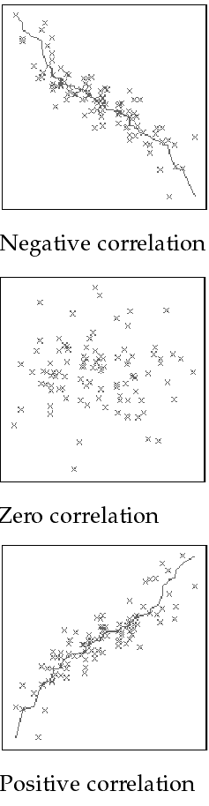

Correlation Coefficient
Also known as the r-value
Measures the strength of the relationship between two variables
Values range between -1 to 1
0 indicates no relationship
± 1 indicates direct relationship
Source: DM Stat
Notes:
To determine whether there is a relationship between population size and usage rate - I used the correlation coefficient formula. The correlation coefficient, also known as the r-value, is a measure of the strength of the relationship between two variables.
The closer the value is to 0 - the weaker the relationship.
The closer the value is to ±1 - the stronger the relationship.
http://www.dmstat1.com/res/TheCorrelationCoefficientDefined.html

Slide 6
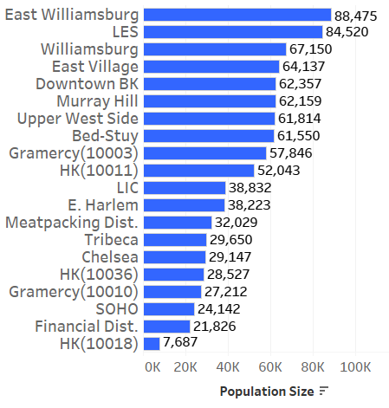
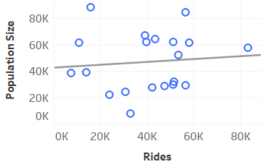
Population Size
Correlation
Coefficient
+0.09
population size not linked to usage rate
Sources: Citi Bike System Data, Zipdatamaps, New York Hometown Locator, Towncharts
Notes:
Unfortunately there is a very weak relationship between population size and usage rate. On the graph - the points are scattered and do not form a discernable pattern. The correlation coefficient reflects this - by having a value that is close to zero.

Slide 7
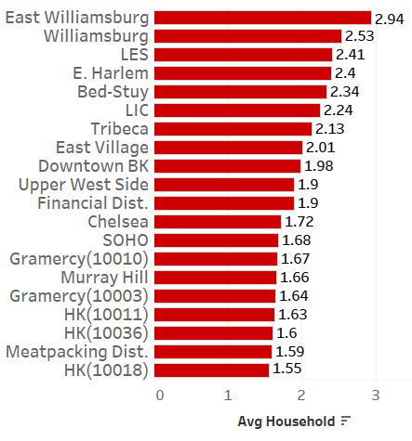
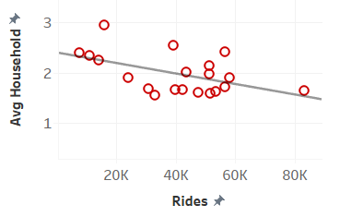
Average Household Size
Correlation
Coefficient
-0.51
as household size decreases - usage rate increases
Sources: Citi Bike System Data, Zipdatamaps, New York Hometown Locator, Towncharts
Notes:
Compared to the population size - the average household size has a stronger correlation with usage rate. The negative r-value implies that as average household size increases - usage rate of citi bike decreases. This is probably due to larger households looking for other forms of transportation with larger capacities - as opposed to using a single capacity bicycle.

Slide 8
Wealth Index
Based on indicators of affluence including:
average household income
average net worth
the value of material possessions and resources
Are relative to the national level
> 100 represent above-average wealth
< 100 represent below-average wealth
Source: New York Hometown Locator
Notes:
The Wealth Index - The Wealth Index is based on a number of indicators of affluence including average household income, average net worth, and the value of material possessions and resources. It represents the wealth of the area relative to the national level.

Slide 9
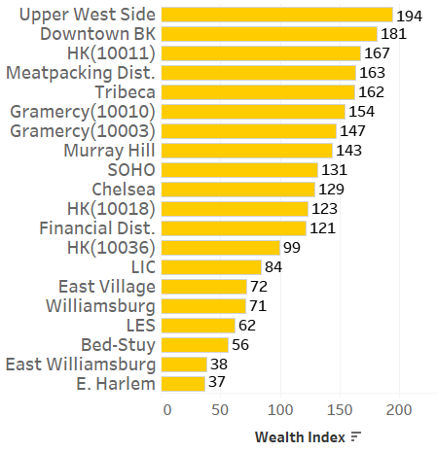
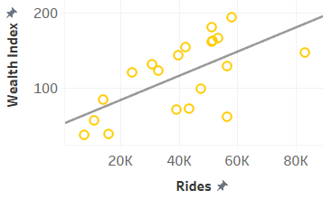
Wealth Index
Correlation
Coefficient
+0.63
as wealth increases usage-rate increases
Sources: Citi Bike System Data, Zipdatamaps, New York Hometown Locator, Towncharts,
Pix11
Notes:
More than half of the neighborhoods in the sample are above 100 on the wealth index.
To get an idea of how the wealth index relates to income
Upper West Side median income: 134K
East Harlem median income: 27K
National Average: 59K
The correlation coefficient suggests that - as the wealth of a neighborhood increases - so does the usage rate.
As reported by pix 11 news: In Neighborhoods with docking stations, the median income is 36K higher than areas with no docking stations
https://pix11.com/2019/07/10/study-citi-bike-is-for-wealthy-white-neighborhoods/

Slide 10
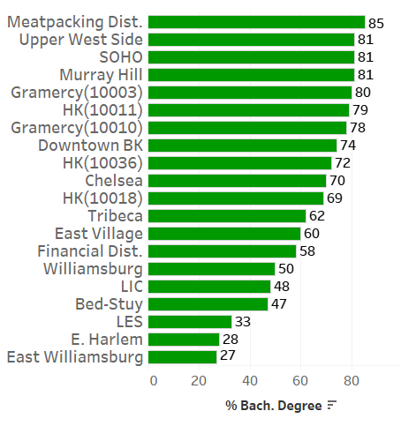
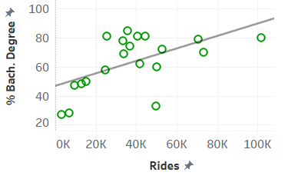
Education
Correlation
Coefficient
+0.56
as education levels increase - usage rates increase
Sources: Citi Bike System Data, Zipdatamaps, New York Hometown Locator, Towncharts
Notes:
Like wealth - education also has a substantial positive correlation with usage rate - as education levels increase - usage rate also increase. This seems reasonable because more education usually brings about more wealth. The r-value of education vs wealth is +0.87 - a very strong positive correlation.

Slide 11
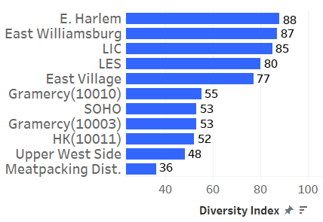
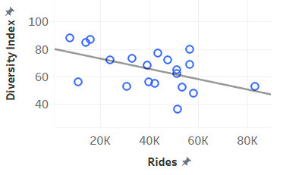
Diversity Index
probability that two people chosen
at random from the same area
belong to a different race/ethnicity
Correlation
Coefficient
-0.50
as diversity decreases usage rate increases
Sources: Citi Bike System Data, Zipdatamaps, New York Hometown Locator, Towncharts,
Gothamist
Notes:
And lastly, The Diversity Index - The Diversity Index is a scale from 0 to 100 that represents the probability that two people
chosen at random from the same area, belong to a different race or ethnicity
According to the correlation coefficient usage rates increase as diversity decreases. This seems sensible because most stations are built around wealthier less-diverse neighborhoods. And according to the gothamist only 16.5 percent of people of color have access to citibike.
https://gothamist.com/news/report-citi-bike-is-leaving-behind-poor-communities-of-color

